Slide 1

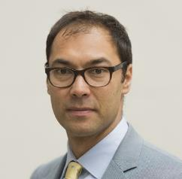

WINNING BUSINESS THROUGH SOCIAL MEDIA
Key considerations for SPA members
HOSTED BY JASON WALKINSHAW & Craig herd

Slide 2
Your speakers
Jason worked with SBR’s parent company for 9 years in our sales and leadership programme. He has recruited, trained and lead award winning teams from across Europe at one point leading a sales organisation of over 125 people. Prior to joining SBR, Jason lead the sales and culture departments at OVO Energy helping the business grow from £18m to £700m in annual revenues. Jason was in charge of the design and implementation of the people plan at OVO where in 2017 OVO Energy was rated the 20th best place to work in the annual Sunday Times list. He specialises in designing and implementing sales and leadership programmes and cultural change.
Jason Walkingshaw
Craig has a passion for driving habitual growth through elevating the practice and perception of sales in organisations across the globe. His 12 year career has involved selling, recruiting, training & leading salespeople across multiple industry sectors including Professional Services, ICT, Financial Services and Travel. Craig also has first-hand experience of multiple routes to market including multiple facets of B2B and B2C based selling.
Craig herd, Consultant

Slide 3










Some of our clients

Slide 4
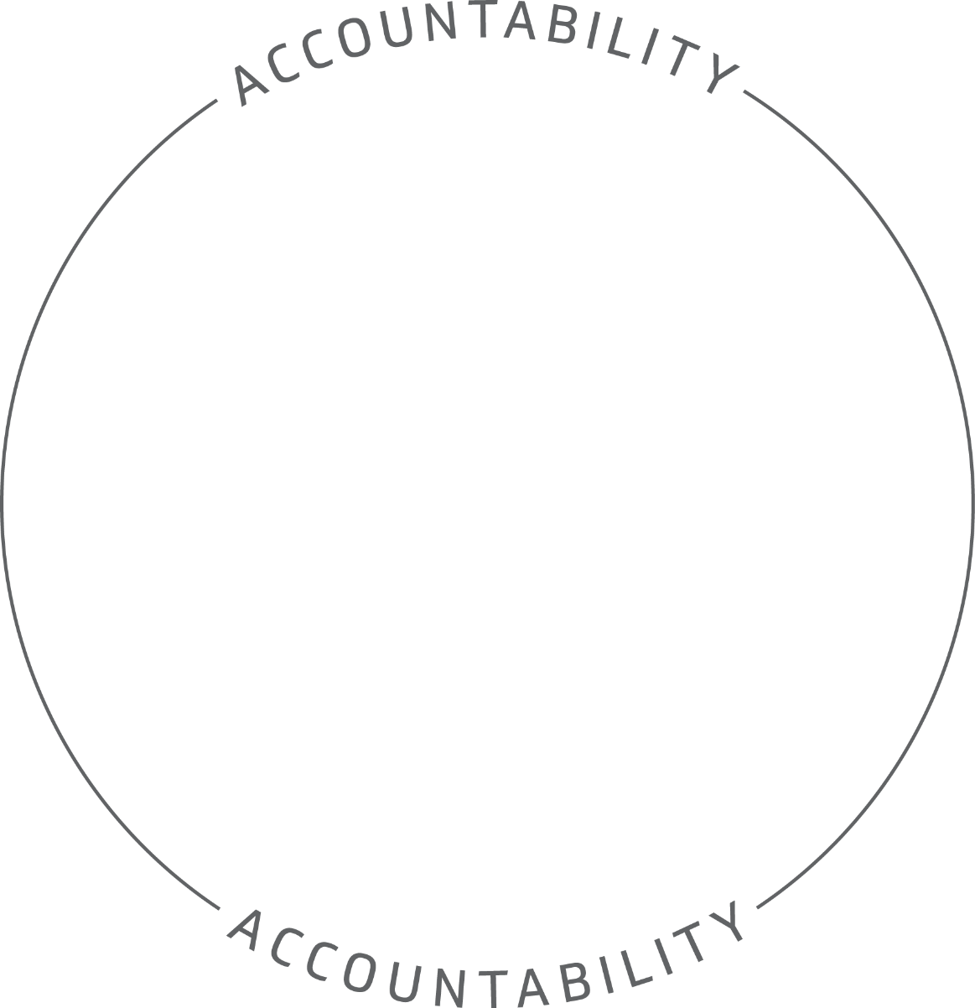




About SBR Consulting
Our aim is to elevate the practice and perception of sales within individuals and organisations and as a result create increased revenue, enhanced professionalism & intelligent activity.

Slide 5

Digitally setting yourself up for success
- Digitally setting yourself up for success
-Proactively making new connections
- Nurturing Sales Opportunities
-Building a Pipeline of Future Clients
-Building a Professional Network

Slide 6
Digitally setting yourself up for success

Slide 7
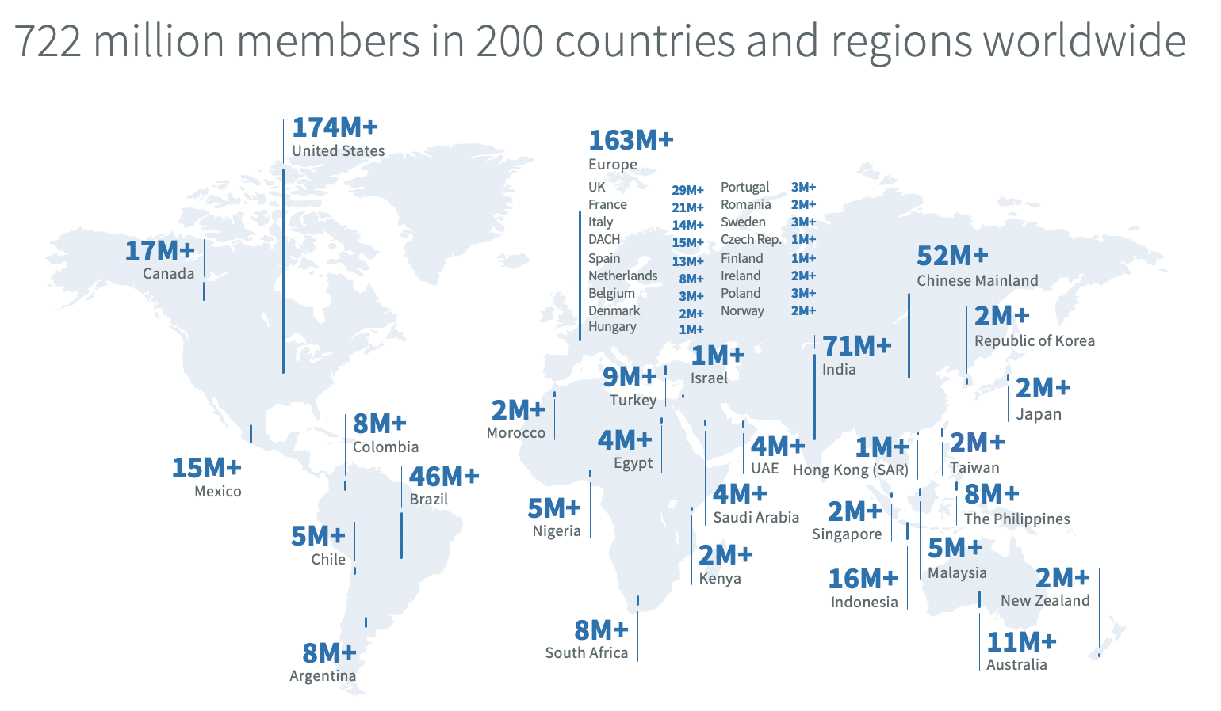
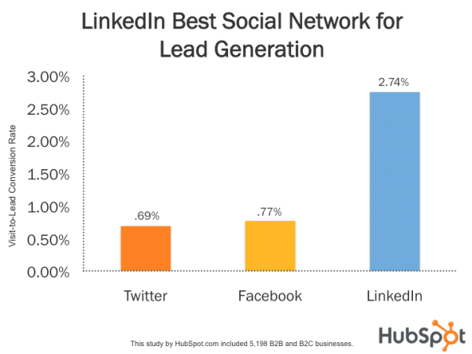
Digitally setting yourself up for success

Slide 8
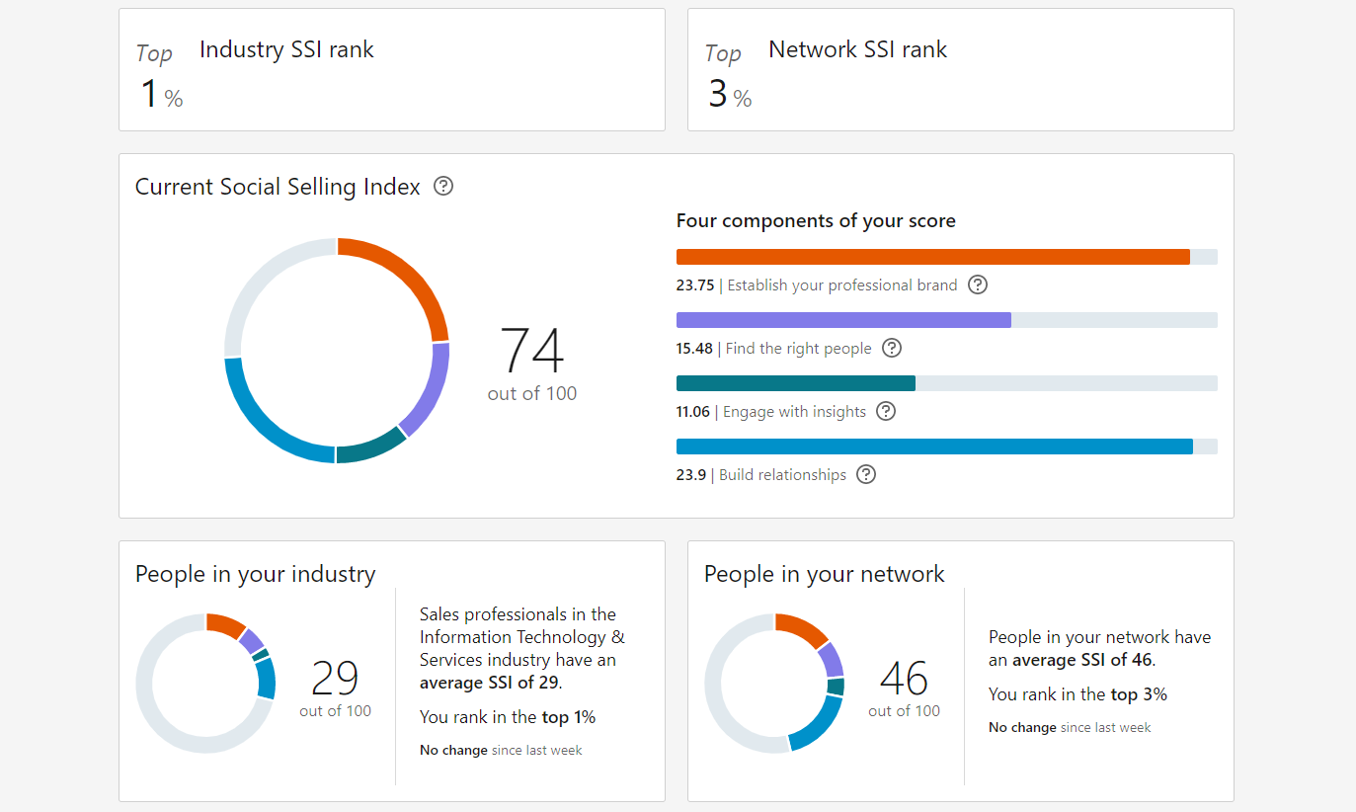
SOCIAL SELLING INDEX
https://www.linkedin.com/sales/ssi

Slide 9
SOCIAL SELLING INDEX
https://www.linkedin.com/sales/ssi

Slide 10
ACTIVITY

Slide 11







Pro.
Profile Set Up (Photo and Cover)
Professionalise your URL
Title- Value Driven I HELP X do Y
About You is not a CV is a conversation
Focus your network
Review your network
Notes:
PROFILE SET UP
Similar corporate background
URL CHANGE- Professional Upgrade
Title -what do you do?
I help…
ABOUT YOU
Liking- okay.
Comment with question
Contact Review

Slide 12
ACTIVITY

Slide 13
PROACTIVELY MAKING NEW CONNECTIONS

Slide 14
Content connection
JEREMONE BONNEVILLE
Notes:
https://www.linkedin.com/feed/update/urn:li:activity:6760107283562205184/

Slide 15
ACTIVITY

Slide 16
Nurturing Sales Opportunities

Slide 17
Content connection
https://www.linkedin.com/feed/update/urn:li:activity:6760107283562205184/
JAY –Fractual Systems

Slide 18
Building a Pipeline of Future Clients

Slide 19





BUYING CYCLE
Satisfaction
Delivery
Event or New Knowledge
  Market
  Business
  Individual
Delivery
STAY CLOSE
Realisation
Decision
Assessment
Notes:
Definition Unaware of or choosing to live with problems that could be solved.
Common mistakes at this point Present solutions without firstly establishing a need.
Correct behaviour To ask questions to help them realise the reality of their situation.
Realisation:
Definition When the penny drops that there is an issue or opportunity that they could/should be dealing with.
Common mistakes at this point Failure to investigate and develop customers need from "nice to have“ to "need to have". Presenting solutions too early.
Correct behaviour To ask questions that explore the consequences, impact or effect of dealing with or ignoring the situation.
Assessment
Definition When the customer is asking themselves "what are my options?” and decides on their decision criteria.
Common mistakes at this point Fail to uncover customers decision criteria and make little or no attempt to influence these criteria in their favour.
Correct behaviour Find out what is most important to them and position your offering as best able to help them.
Explain need for budget plan and business case the client is doing internally. .
Decision
Definition When the customer is asking themselves, "what’s my best option" and looking at the risks and which option best mitigates risk.
Common mistakes at this point Fail to uncover/deal with concerns in the hope that they will go away. Pressurising the customer to make a decision.
Correct behaviour Checking that the customer has info that they need, using TPV/reference stories, walking them through the decision making process.
Delivery

Slide 20
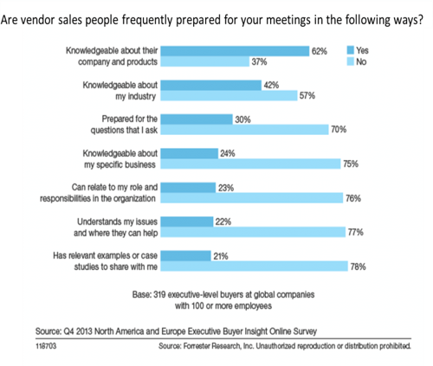
What do vendors want?

Slide 21
ACTIVITY

Slide 22
positioning your value
Client Concerns
Your Value Add
Your differentiated capabilities

Slide 23
Building a
Professional Network

Slide 24




What is networking NOT?
Using your friends to get business
Professional speed dating
Some common misconceptions
Always asking for business
Having lots of shallow conversations

Slide 25
What is networking?
Building mutually beneficial long-term relationships with other professionals

Slide 26
Developing and engaging with your network virtually
What is the value of building your network?

Slide 27




The value of consciously developing & nurturing a strong network of professional contacts…
When done correctly…
Hard work at top of funnel, helps achieve easy wins at bottom of funnel.
Gives you better understanding of market & key issues.
Smooth out cycle of being reliant on reactive opportunities.
Increase your number of ‘walk ins’.

Slide 28




Developing and engaging with your network virtually
It’s not
‘quantity or quality of contacts’
But
‘quantity of quality’
that is important.

Slide 29



Characteristics of a rich professional network
High number of purchasers: Budgetary sign off & discretionary control of budgets (& rising stars that will in the future)
High number of connectors:
Contacts who help you get in front of purchasers.
Highly concentrated:
From specific industries, regions or functions.

Slide 30


Developing and engaging with your network virtually
Nurture the relationship - stay top of mind by adding value to them
MEETING
CONTACT
CONTACT
MEETING
CONTACT
CONTACT
MEETING
CONTACT
CONTACT
MEETING
CONTACT
CONTACT
Challenge their perception - educate them about what you do
Find ways to engage them – if you haven’t already!
Identify the right people to know and the value that you add
When appropriate make requests to create opportunity

Slide 31
Growing your network – sources of existing contacts
Pursued… Always? Sometimes? Never?
01
LinkedIn contacts.
05
Interest / affinity groups.
02
06
Delegates from conferences / business briefings.
CRM contacts.
03
Old business cards (sitting in your top drawer).
07
Lost opportunities / proposals.
04
Alumni directories / group.
08
Previous clients.

Slide 32
Growing your network – sources of existing contacts
Pursued… Always? Sometimes? Never?
01
Conferences / association meetings – get delegate lists.
06
Conduct a survey / research project.
02
Give speeches – conferences / association meetings.
07
Meet everyone that attends a meeting.
03
08
Make calls to industry names (LinkedIn, publications).
Join associations.
04
Publish articles / blogs / podcasts / webinars in relevant publications.
09
Pro bono work for industry organisations.
05
10
Host events (breakfast events / evening events / lunch…).
Lunch and learns.

Slide 33




Adding value to your contacts
Introductions/ referrals
Invites to events / webinars
Relevant whitepapers
Your insight

Slide 34
Opening up a conversation with an old contact
“It was good to reconnect with you on LinkedIn; it made me realize that we haven’t talked in a while. How are you?”
“I just reconnected with (person’s name that you both know) and realized that we haven’t talked in a while. How are things going for you?”
“I just read an article on your firm in (publication) and thought of you. (Elaborate a bit on the article)… Just wanted to touch base to say hello and see how you were doing.”

Slide 35
Opening up a conversation with an old contact
“I’m going to the (organisation) virtual conference in December and was wondering if you planned on attending. I thought it might be nice to reconnect afterwards and discuss thoughts. Do you plan on attending?”
“I’m considering writing an article on (topic) and thought of you because I knew you would be a great person to give me a valuable perspective on it. Could I trouble you to arrange a call to get your point of view on (topic)?”

Slide 36
Developing and engaging with your network virtually
I didn’t realise they had changed roles…
How did they get that job…!?
I should reach out to them / I haven’t spoken to them for a while

Slide 37
Developing and engaging with your network virtually
“We go in do a great job and hopefully we get introduced around the organisation / to other contacts”
Access Strategies
Hope
Give to get
Referral / Introduction
Proactively reach out…
Workshop
Briefing session
Project wrap up meeting)
Ask your promoters
Sell the value to them of the referral/introduction
Trade access – “if you …then I” (should be on your variables list)
Linked in approach (ideally through a recommender)

Slide 38
positioning statement
Who you work for / role | “I work for. . ., I am . . .
The value you provide and who are provide it to | We/I help clients like . . . . . . to . . . . . . (not the features but the benefits of what you do)”. Add value. Give to get; earn the right to engage.
The method that you use | By . . .

Slide 39
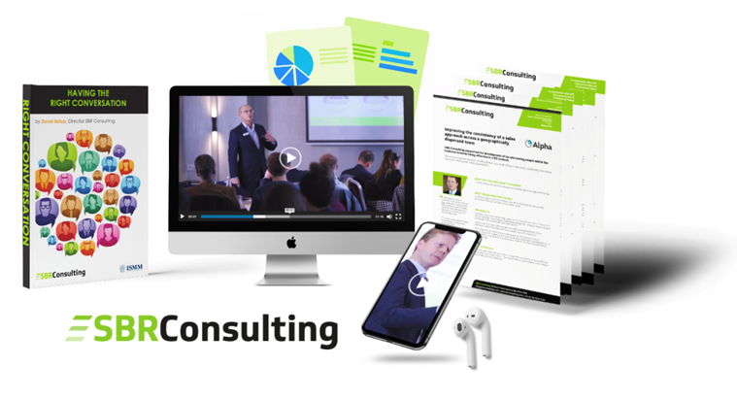
Spa Sales hotline & FREE GIFT
- Recording of the initial two SPA/SPR webinars
- Enrolment into the SBR Community
- 30 Minute Sales Clinic
- Invitation to our own upcoming webinar
‘Sales and Marketing ‘How to Maximise The Power of Both’
Dedicated Email Support
All as part of your SPA Membership
SPA-Sales@sbrconsulting.com
EMAIL TITLE ‘SPA’

